Slide 1

An Exploration of the Relationship Between
Crime & Home Value
CWRU Data Bootcamp: Team 6
Notes:
PRESENTER: MIKE

Slide 2
Hypothesis
An increase in local crime rates has a negative impact on real estate prices.
Notes:
PRESENTER: MIKE

Slide 3
Methodology & Data Sources
Data Sources
Crime (Lakewood) (Socrata, time series)
Crime (Elyria) (Socrata, time series)
Real Estate (Zillow, time series)
Data Collection & Analysis
Conducting API calls, importing csv data
Recoding (e.g., correcting human input errors and inconsistencies)
Cleaning (e.g., removing outliers)
Smoothing for erratic data (rolling means)
Inner joins on data sets using zip, year, and month
Plotting & correlation analysis (r and r-square) to explore statistical relationships
Key Libraries
Pandas, Numpy, Matplotlib (including patches), requests, time, csv, pprint, json, google.colab, scipy.stats
Notes:
PRESENTER: MIKE

Slide 4
If you only remember three things
(i.e., Executive Summary)
1
Overall crime rates in the communities we explored (Lakewood and Elyria, Ohio) appear to impact the home prices in each respective community, explaining as much as 40% of the variance.
2
Specific types of crimes can impact home prices more significantly. For example, breaking and entering impacts home prices more significantly than crimes such as trespassing and vandalism.
3
Recent trends appear to be driving much of the correlation between crime and home prices, so don’t ‘mortgage the house’ to bet on the housing markets using crime rates as a leading indicator.
Notes:
PRESENTER: MIKE

Slide 5
Detailed Findings
Notes:
TRANSITION: KINGSLEY

Slide 6
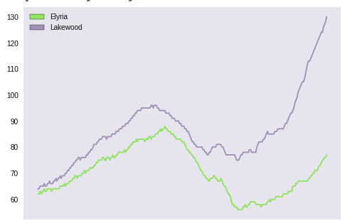
Real estate prices in Lakewood and Elyria have fluctuated, but are currently on the rise
Housing Prices, Cost Per Square Foot
Aug 2005
Price Per Square Foot, Dollars
Dec 2011
Months (Indexed): 2010 - 2018
Notes:
PRESENTER: KINGSLEY
10 months rolling average smoothed out. 10 years of data by month overall.

Slide 7
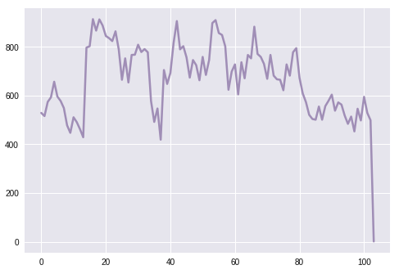
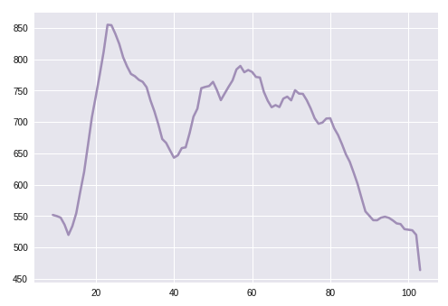
While seasonal, overall crime rates in Lakewood are in decline
Lakewood Crime Data - Raw
Lakewood Crime Data - Cleaned & Smoothed
Reported Crimes (Total Incidents)
Reported Crimes (Total Incidents)
Dec 2012
Late outliers suggest slow reporting or systems updating
Month (Indexed): 2010 - 2018
Month (Indexed): 2010 - 2018
Notes:
PRESENTER: KINGSLEY

Slide 8
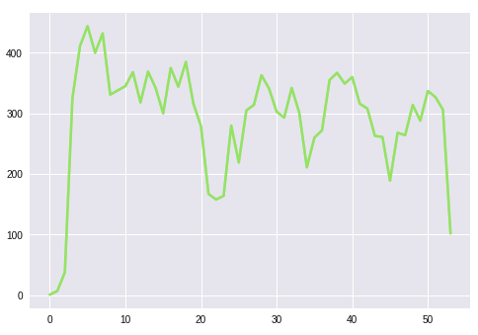
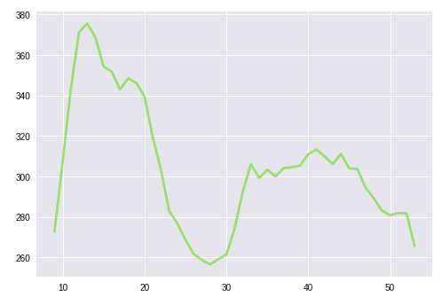
Similarly, crime rates in Elyria have largely declined in recent years
Elyria Crime Data - Raw
Elyria Crime Data - Cleaned & Smoothed
Reported Crimes (Total Incidents)
Reported Crimes (Total Incidents)
Feb 2013
Early outliers suggest slow adoptions of new crime reporting systems
Month (Indexed): 2010 - 2015
Month (Indexed): 2010 - 2015
Notes:
PRESENTER: KINGSLEY
X axis is a smoothed value of crime events of each 1o months.

Slide 9
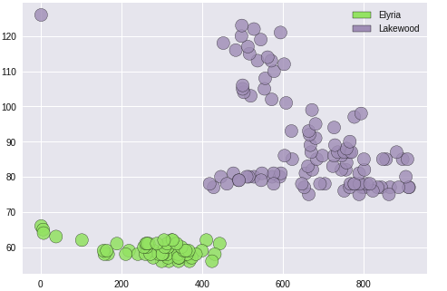
A scatter diagram of crime rates and home values hint at a relationship, but we need to go deeper...
Crime Rates & Home Values Scatter
Price Per Square Foot, Dollars
Reported Crimes (Total Incidents)
Notes:
PRESENTER: KINGSLEY

Slide 10
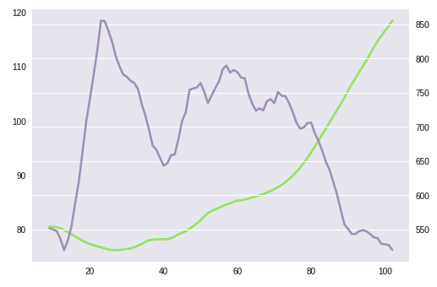
When scales are adjusted, we see a clear relationship between home prices & crime rates
Cleaned Lakewood Crime Rates & Real Estate Prices
Recent trends are driving much of the correlation
r: -0.63, p<.001
r-square: 0.40
Interpretation: In Lakewood, 40% of the variance in crime rates can explain the variance in home prices.
Reported Crimes (Total Incidents) (Purple)
Price Per Square Foot, Dollars (Green)
Month (Indexed): 2010 - 2018
Notes:
PRESENTER: FAITH

Slide 11
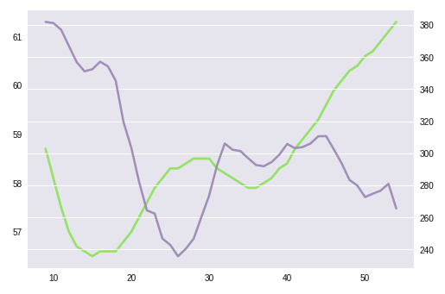
A similar, though less prevalent pattern holds in Elyria
Cleaned Elyria Crime Rates & Home Prices
r: -0.46, p=.001
r-square: 0.21
Interpretation: In Elyria, 21% of the variance in crime rates can explain the variance in home prices.
Recent trends are driving much of the correlation
Reported Crimes (Total Incidents) (Purple)
Price Per Square Foot, Dollars (Green)
Month (Indexed): 2011 - 2015
Notes:
PRESENTER: FAITH

Slide 12
But what about specific types of crimes?
Notes:
TRANSITION: JEREMY

Slide 13
Breaking & Entering
Notes:
PRESENTER: JEREMY

Slide 14
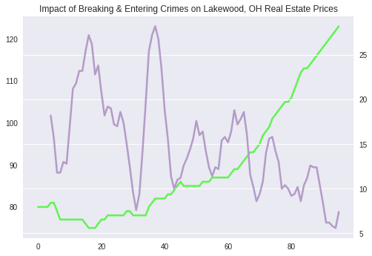
The overall pattern again holds in Lakewood in the breaking and entering crime category...
Impact of Breaking and Entering, Lakewood
r: -0.53, p<.001
r-square: .28
Interpretation: In Lakewood, 28% of the variance in breaking and entering crime rates can explain the variance in home prices.
Reported Crimes (Total Incidents) (Purple)
Price Per Square Foot, Dollars (Green)
Month (Indexed): 2011 - 2015
Notes:
PRESENTER: FAITH

Slide 15
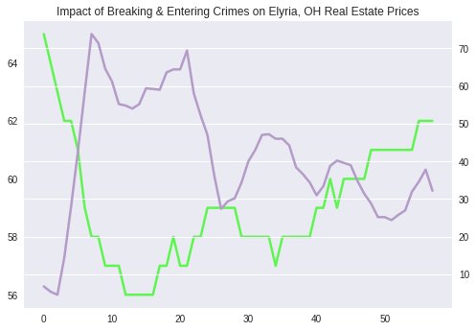
… and is similar in Elyria
Impact of Breaking and Entering, Elyria
r: -0.48, pp<.001
r-square: .23
Interpretation: In Elyria, 23% of the variance in breaking and entering crime rates can explain the variance in home prices.
Reported Crimes (Total Incidents) (Purple)
Price Per Square Foot, Dollars (Green)
Month (Indexed): 2011 - 2015
Notes:
PRESENTER: FAITH

Slide 16
Defined as damage to property, criminal damaging / endangering, trespassing, vandalism
Property Crimes
Notes:
PRESENTER: JEREMY

Slide 17
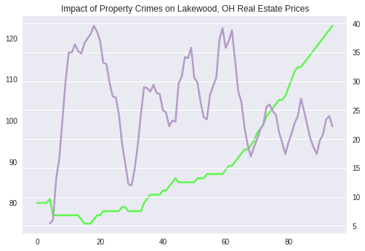
Property crime in Lakewood is not as predictive of housing costs and has the lowest significance level
Property Crime, Lakewood
r: -0.21, p=<.05
r-square: .04
Interpretation: In Lakewood, just 4% of the variance in property crimes rates can explain the variance in home prices.
Reported Crimes (Total Incidents) (Purple)
Price Per Square Foot, Dollars (Green)
Month (Indexed): 2011 - 2015
Notes:
PRESENTER: FAITH

Slide 18
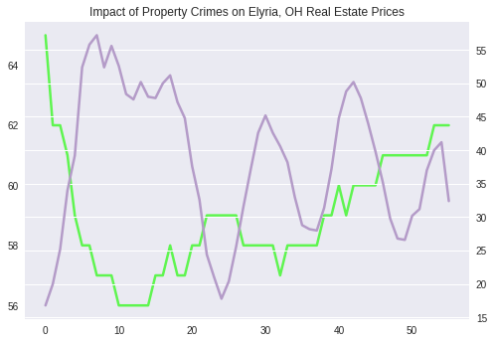
Similarly, housing costs in Elyria is not as closely tied to property crime rates
Property Crime, Elyria
r: -0.34, p=.01
r-square: .12
Interpretation: In Elyria, 12% of the variance in property crime rates can explain the variance in home prices.
Reported Crimes (Total Incidents) (Purple)
Price Per Square Foot, Dollars (Green)
Month (Indexed): 2011 - 2015
Notes:
PRESENTER: FAITH

Slide 19
Caveats & Considerations
Notes:
TRANSITION: ANTHONY

Slide 20
Friendly Reminder
If you only remember three things
1
Overall crime rates in the communities we explored (Lakewood and Elyria, Ohio) appear to impact the home prices in each respective community, explaining as much as 40% of the variance.
2
Specific types of crimes can impact home prices more significantly. For example, breaking and entering impacts home prices more significantly than crimes such as trespassing and vandalism.
3
Recent trends appear to be driving much of the correlation between crime and home prices, so don’t ‘mortgage the house’ to bet on the housing markets using crime rates as a leading indicator.
Notes:
PRESENTER: ANTHONY

Slide 21
Caveats & Considerations
Crime data seems particularly prone to human error, given humans input qualitative information into systems.
Crime rate decline could also be explained by changes in reporting techniques, versus actual declines in crime itself
A more robust analysis would need to control for other variables that can influence home prices (e.g., school quality, etc.).
More recent trends appear to be driving much of the correlation, so a longer term analysis is necessary to draw definitive conclusions.
This analysis only includes two communities. To make broader citywide or national assessments, we would need to include more communities / regions.
Notes:
PRESENTER: ANTHONY

Slide 22
Discussion + Questions

Slide 23







Slide 24
Resources

Slide 25
Resources
Google Colab Notebook
Proposal
Data Sources
Crime (Lakewood) (Socrata)
Crime (Elyria) (Socrata) Real Estate (Zillow)

